Slide 1
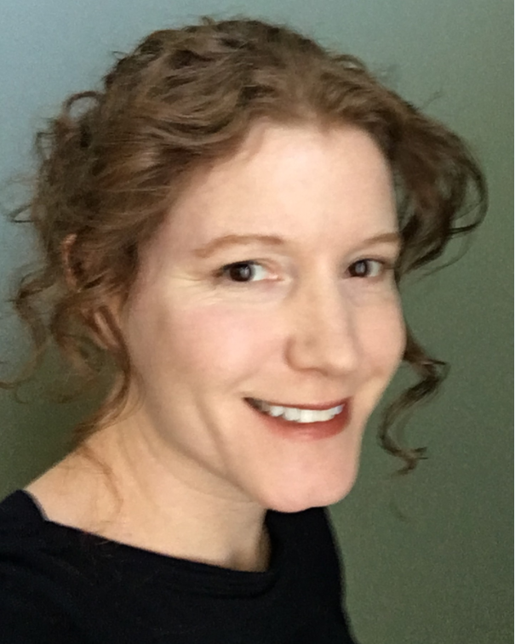
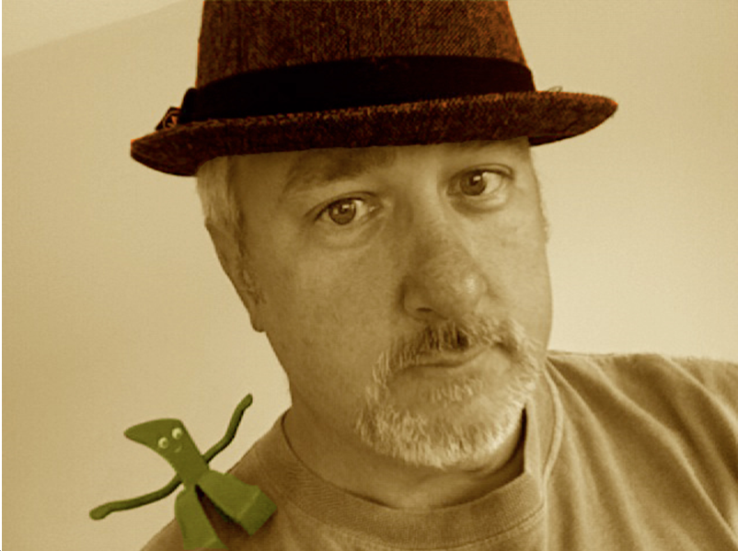
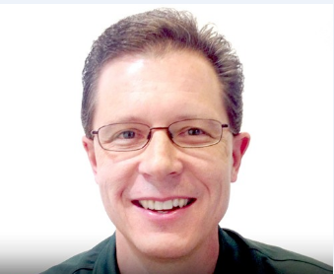
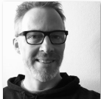
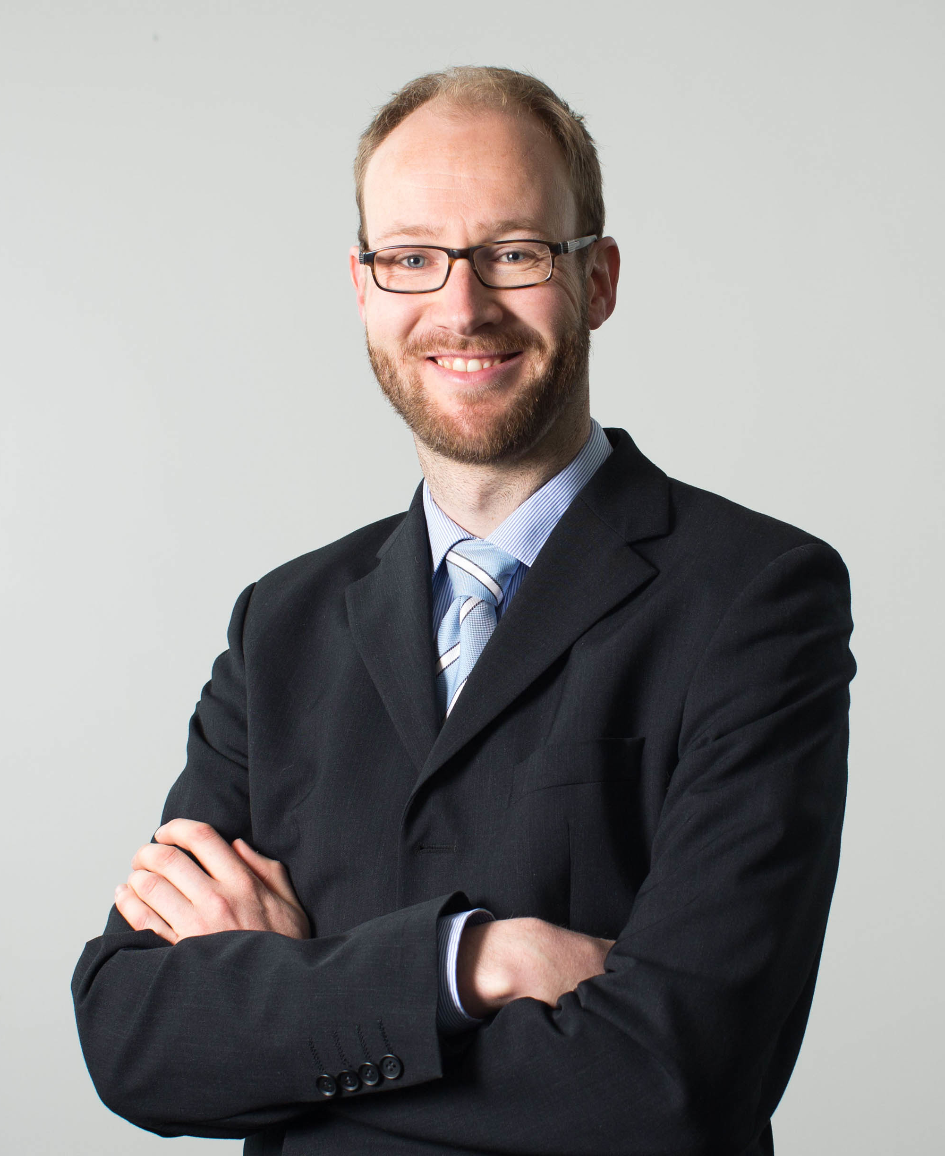
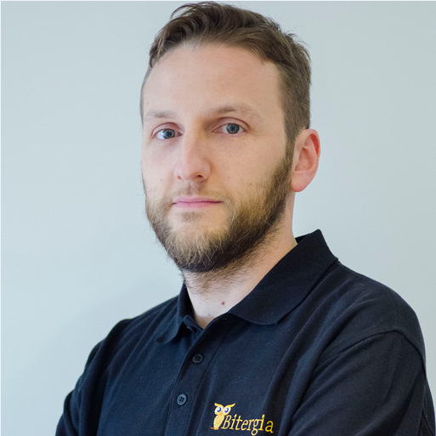
Panelists
Erin Bank
Sr. Director, Engineering Program Mgmt., CA Technologies
kruer01@gmail.com
Georg Grütter
Senior Expert, Social Coding Evangelist Robert Bosch GmbH
Georg.Gruetter@de.bosch.com
Daniel Izquierdo
Bitergia, Chief Data Officer
dizquierdo@bitergia.com
Jim Jagielski
Director, Apache Software Foundation
jimjag@gmail.com
Guy Martin
Director, Open@Autodesk
guy.martin@autodesk.com
Dr. Klaas-Jan Stol
Lecturer, School of Computer Science and Technology at University College Cork
kjstol@gmail.com

